Slide 1
Acknowledgement of Country and Prayer of Acknowledgement
Australian Council of the Laity of the Chevalier Family
Laity of the Chevalier Family Australia
Spirituality of the Heart in an Australian Lay Context

Slide 2
Acknowledgement of Country
Laity of the Chevalier Family Australia
Spirituality of the Heart in an Australian Lay Context

Slide 3
Acknowledgement of Country
With deep respect and love, we acknowledge the Aboriginal and Torres Strait Islander people, the traditional custodians of this land.
We honour their continued deep connection to Country and are nourished and inspired by their wisdom, experiences, and spirituality.
We pay our respects to their Elders - past, present, and emerging.
With spirit-filled hearts, we commit to building together a future inspired by reconciliation, inclusion, care for Country, hope, and love.
Laity of the Chevalier Family Australia
Spirituality of the Heart in an Australian Lay Context

Slide 4
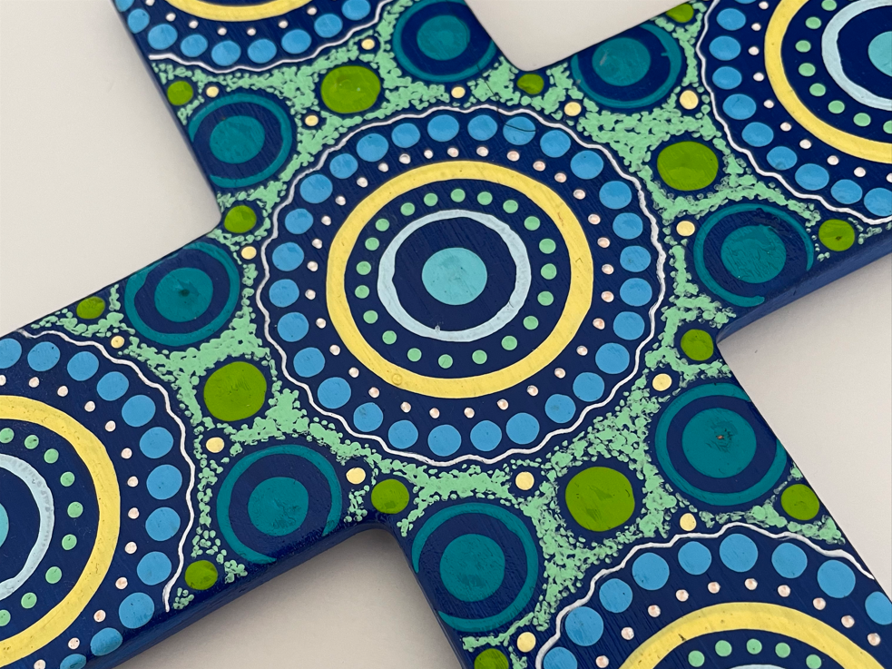
Prayer of Acknowledgement
Laity of the Chevalier Family Australia
Spirituality of the Heart in an Australian Lay Context

Slide 5
Prayer of Acknowledgement
Holy Spirit, we pray for your blessing on this Country and those gathered today.
We pray for the Aboriginal and Torres Strait Islander people and their Elders - past, present, and emerging.
May their continued deep connection to Country, and their wisdom, experiences, and spirituality, continue to inspire and nurture us.
Help us build a future inspired by reconciliation, inclusion, care for Country, hope, and love.
Amen.
Laity of the Chevalier Family Australia
Spirituality of the Heart in an Australian Lay Context

