Slide 1
Follow the Star
Advent Calendar
Aidan Johnson
Laity of the Chevalier Family Australia
Spirituality of the Heart in an Australian Lay Context

Slide 2
Follow the Star Advent Calendar
Laity of the Chevalier Family Australia
Spirituality of the Heart in an Australian Lay Context

Slide 3
Laity of the Chevalier Family Australia
Spirituality of the Heart in an Australian Lay Context
Notes:
Introduction to Advent Calendar. (Follow The Star)

Slide 4
Laity of the Chevalier Family Australia
Spirituality of the Heart in an Australian Lay Context
Notes:
Read Michael Fallon's entire homily. (Week of Hope) (Heart for God)

Slide 5
Laity of the Chevalier Family Australia
Spirituality of the Heart in an Australian Lay Context
Notes:
Get Moving. (Week of Hope) (Heart for Self)

Slide 6
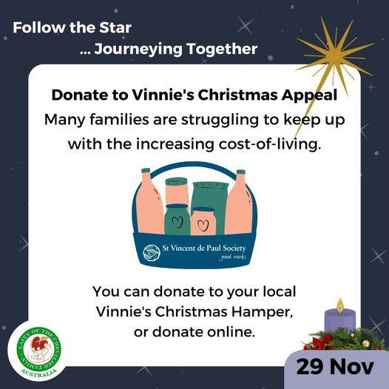
Laity of the Chevalier Family Australia
Spirituality of the Heart in an Australian Lay Context
Notes:
Donate to the Vinnie's Christmas Appeal. (Week of Hope) (Heart for Justice)

Slide 7
Laity of the Chevalier Family Australia
Spirituality of the Heart in an Australian Lay Context
Notes:
Create an Advent Wreath. (Week of Hope) (Reflective Heart)

Slide 8
Laity of the Chevalier Family Australia
Spirituality of the Heart in an Australian Lay Context
Notes:
Register to become a citizen scientist. (Week of Hope) (Heart for Creation)

Slide 9
Laity of the Chevalier Family Australia
Spirituality of the Heart in an Australian Lay Context
Notes:
Read 'A Heart for Creation at Christmas'. (Week of Hope) (Heart for Learning)

Slide 10
Laity of the Chevalier Family Australia
Spirituality of the Heart in an Australian Lay Context
Notes:
Get in Touch. (Week of Hope) (Heart for Others)

Slide 11
Laity of the Chevalier Family Australia
Spirituality of the Heart in an Australian Lay Context
Notes:
Read Michael Fallon's entire homily. (Week of Peace) (Heart for God)

Slide 12
Laity of the Chevalier Family Australia
Spirituality of the Heart in an Australian Lay Context
Notes:
Meditate. (Week of Peace) (Heart for Self)

Slide 13
Laity of the Chevalier Family Australia
Spirituality of the Heart in an Australian Lay Context
Notes:
Sign the Uluru Statement Canvas. (Week of Peace) (Heart for Justice)

Slide 14
Laity of the Chevalier Family Australia
Spirituality of the Heart in an Australian Lay Context
Notes:
Pray Peace into Someone’s Life. (Week of Peace) (Reflective Heart)

Slide 15
Laity of the Chevalier Family Australia
Spirituality of the Heart in an Australian Lay Context
Notes:
Do Some Stargazing. (Week of Peace) (Heart for Creation)

Slide 16
Laity of the Chevalier Family Australia
Spirituality of the Heart in an Australian Lay Context
Notes:
Read the Pope's Message. (Week of Peace) (Heart for Learning)

Slide 17
Laity of the Chevalier Family Australia
Spirituality of the Heart in an Australian Lay Context
Notes:
Resolve a Conflict. (Week of Peace) (Heart for Others)

Slide 18
Laity of the Chevalier Family Australia
Spirituality of the Heart in an Australian Lay Context
Notes:
Read Michael Fallon's entire homily. (Week of Love) (Heart for God)

Slide 19
Laity of the Chevalier Family Australia
Spirituality of the Heart in an Australian Lay Context
Notes:
Treat Yourself! (Week of Love) (Heart for Self)

Slide 20
Laity of the Chevalier Family Australia
Spirituality of the Heart in an Australian Lay Context
Notes:
Make a Meal for Someone. (Week of Love) (Heart for Justice)

Slide 21
Laity of the Chevalier Family Australia
Spirituality of the Heart in an Australian Lay Context
Notes:
Offer a Prayer of Gratitude. (Week of Love) (Reflective Heart)

Slide 22
Laity of the Chevalier Family Australia
Spirituality of the Heart in an Australian Lay Context
Notes:
Plant a Tree. (Week of Love) (Heart for Creation)

Slide 23
Laity of the Chevalier Family Australia
Spirituality of the Heart in an Australian Lay Context
Notes:
Visit gambay.com.au to get started. (Week of Love) (Heart for Learning)

Slide 24
Laity of the Chevalier Family Australia
Spirituality of the Heart in an Australian Lay Context
Notes:
Visit a Family Member. (Week of Love) (Heart for Others)

Slide 25
Laity of the Chevalier Family Australia
Spirituality of the Heart in an Australian Lay Context
Notes:
Read Michael Fallon's entire homily. (Week of Joy) (Heart for God)

Slide 26
Laity of the Chevalier Family Australia
Spirituality of the Heart in an Australian Lay Context
Notes:
Have Some Fun! (Week of Joy) (Heart for Self)

Slide 27
Laity of the Chevalier Family Australia
Spirituality of the Heart in an Australian Lay Context
Notes:
Send a Christmas Card. (Week of Joy) (Heart for Justice)

Slide 28
Laity of the Chevalier Family Australia
Spirituality of the Heart in an Australian Lay Context
Notes:
Create a Nativity Scene. (Week of Joy) (Reflective Heart)

Slide 29
Laity of the Chevalier Family Australia
Spirituality of the Heart in an Australian Lay Context
Notes:
Play in Nature. (Week of Joy) (Heart for Creation)

Slide 30
Laity of the Chevalier Family Australia
Spirituality of the Heart in an Australian Lay Context
Notes:
Learn to Sign Merry Christmas. (Week of Joy) (Heart for Learning)

Slide 31
Laity of the Chevalier Family Australia
Spirituality of the Heart in an Australian Lay Context
Notes:
Write a Thank You Note. (Week of Joy) (Heart for Others)

Slide 32
Laity of the Chevalier Family Australia
Spirituality of the Heart in an Australian Lay Context
Notes:
Write a Thank You Note. (Week of Joy) (Heart for Others)

