Slide 1
Carbon Fast
Lenten Calendar
Aidan Johnson
Laity of the Chevalier Family Australia
Spirituality of the Heart in an Australian Lay Context

Slide 2
Carbon Fast Lenten Calendar
Laity of the Chevalier Family Australia
Spirituality of the Heart in an Australian Lay Context

Slide 3
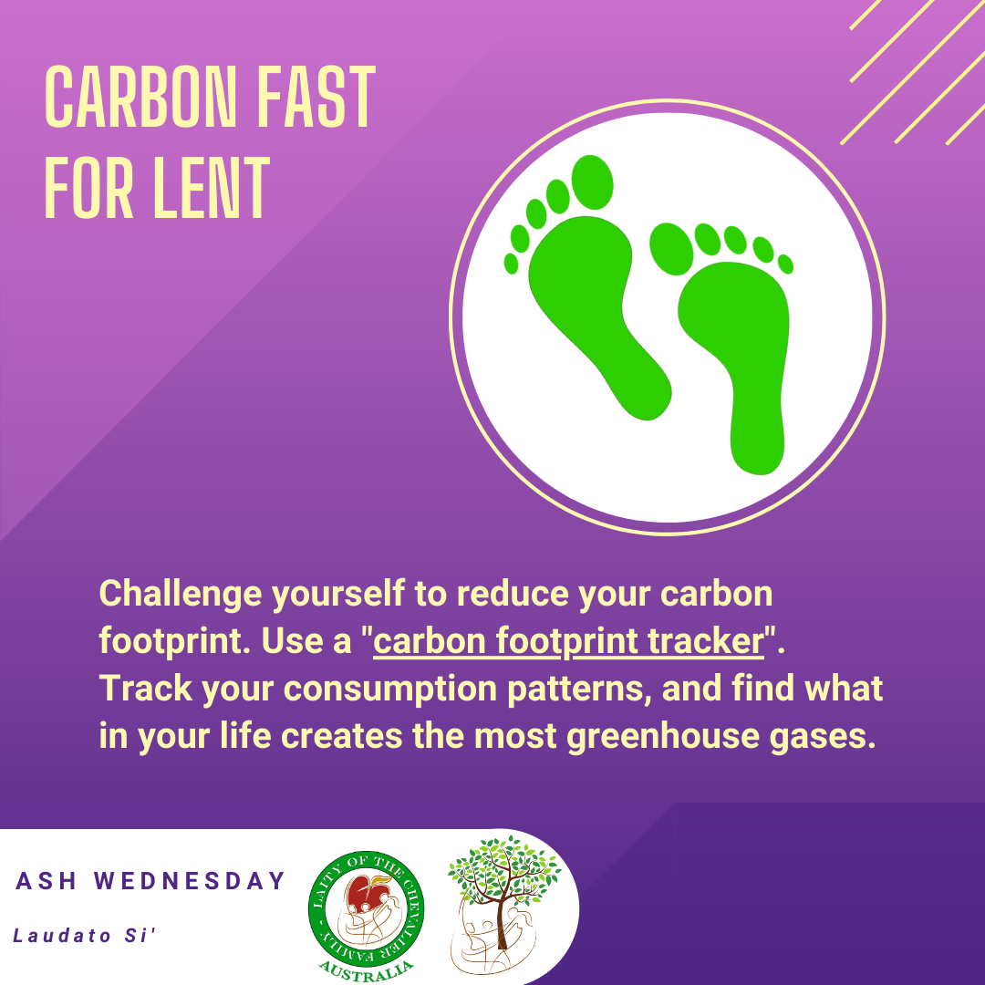
Laity of the Chevalier Family Australia
Spirituality of the Heart in an Australian Lay Context

Slide 4
Laity of the Chevalier Family Australia
Spirituality of the Heart in an Australian Lay Context

Slide 5
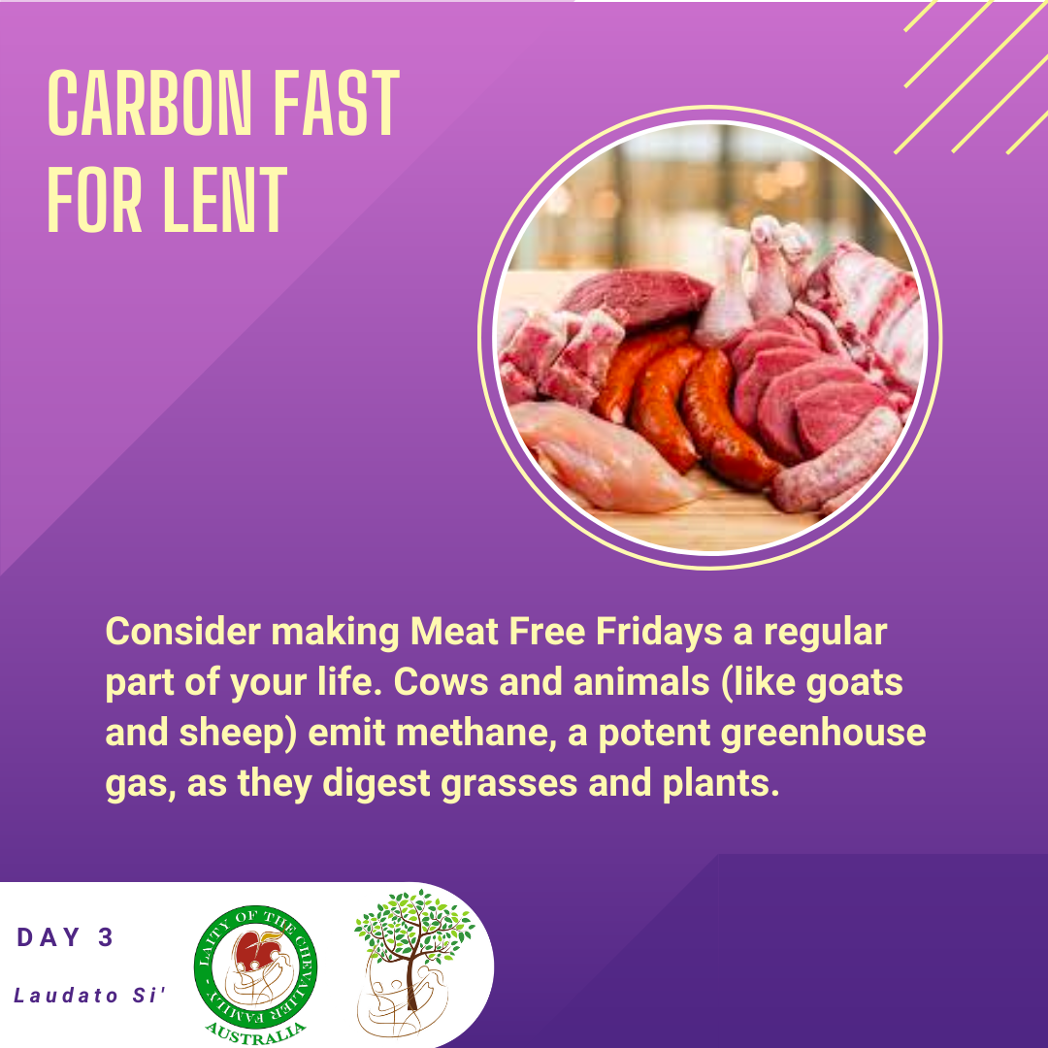
Laity of the Chevalier Family Australia
Spirituality of the Heart in an Australian Lay Context

Slide 6
Laity of the Chevalier Family Australia
Spirituality of the Heart in an Australian Lay Context

Slide 7
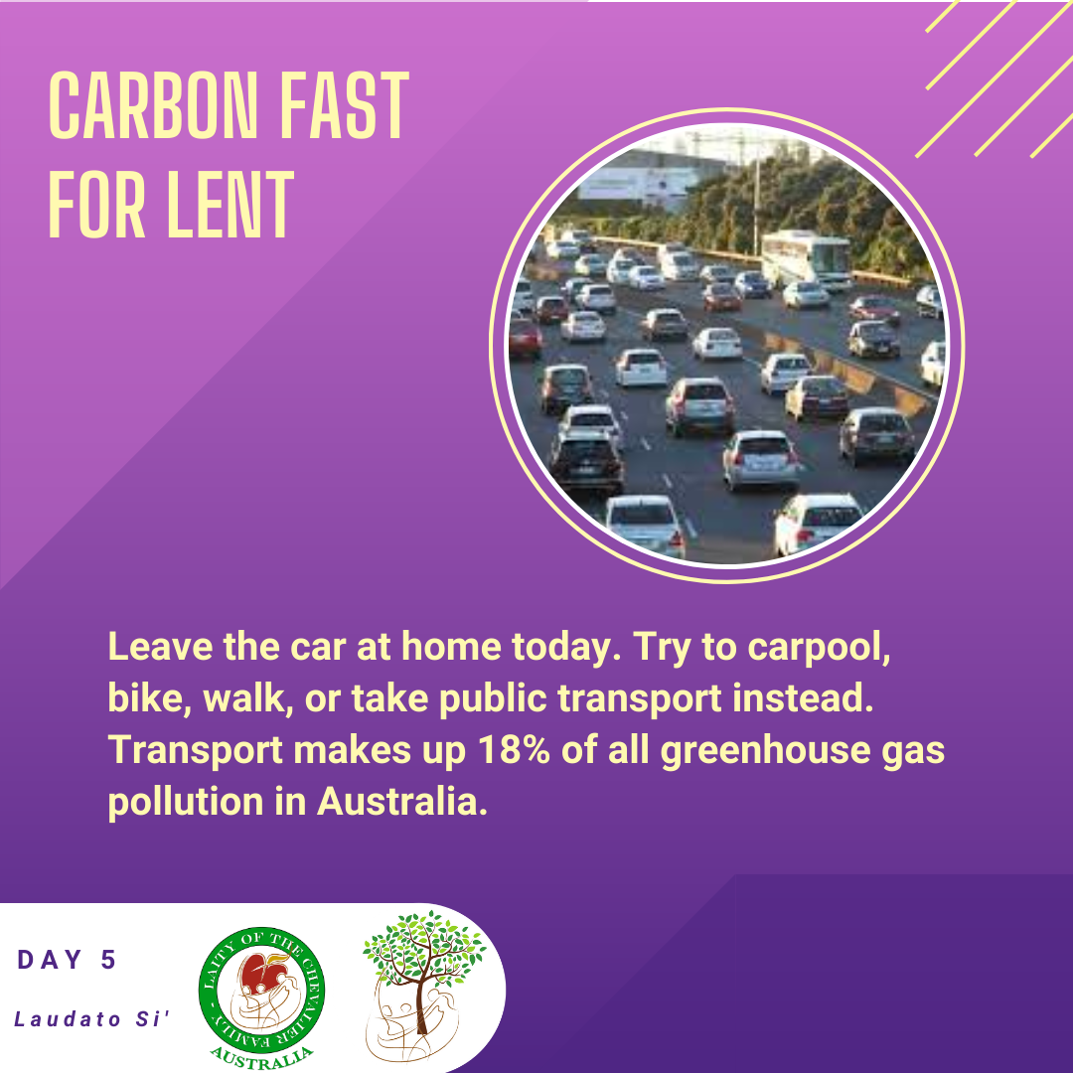
Laity of the Chevalier Family Australia
Spirituality of the Heart in an Australian Lay Context

Slide 8
Laity of the Chevalier Family Australia
Spirituality of the Heart in an Australian Lay Context

Slide 9
Laity of the Chevalier Family Australia
Spirituality of the Heart in an Australian Lay Context

Slide 10
Laity of the Chevalier Family Australia
Spirituality of the Heart in an Australian Lay Context

Slide 11
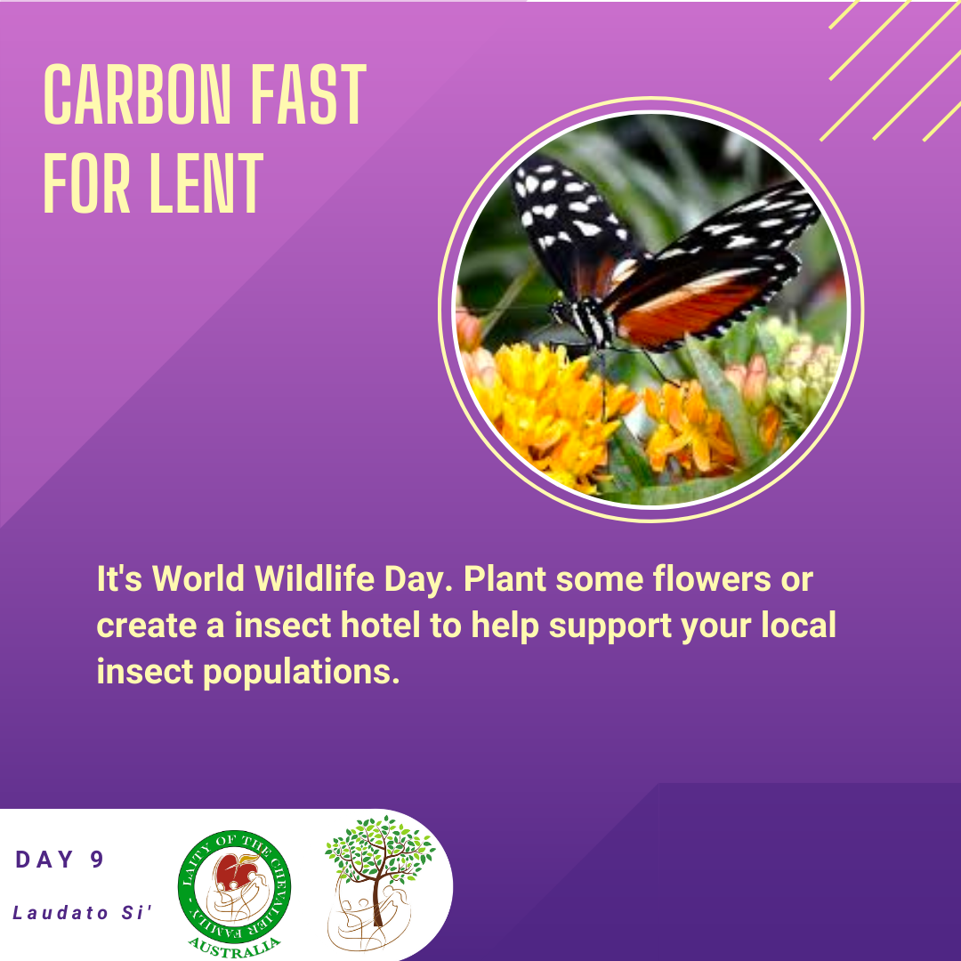
Laity of the Chevalier Family Australia
Spirituality of the Heart in an Australian Lay Context

Slide 12
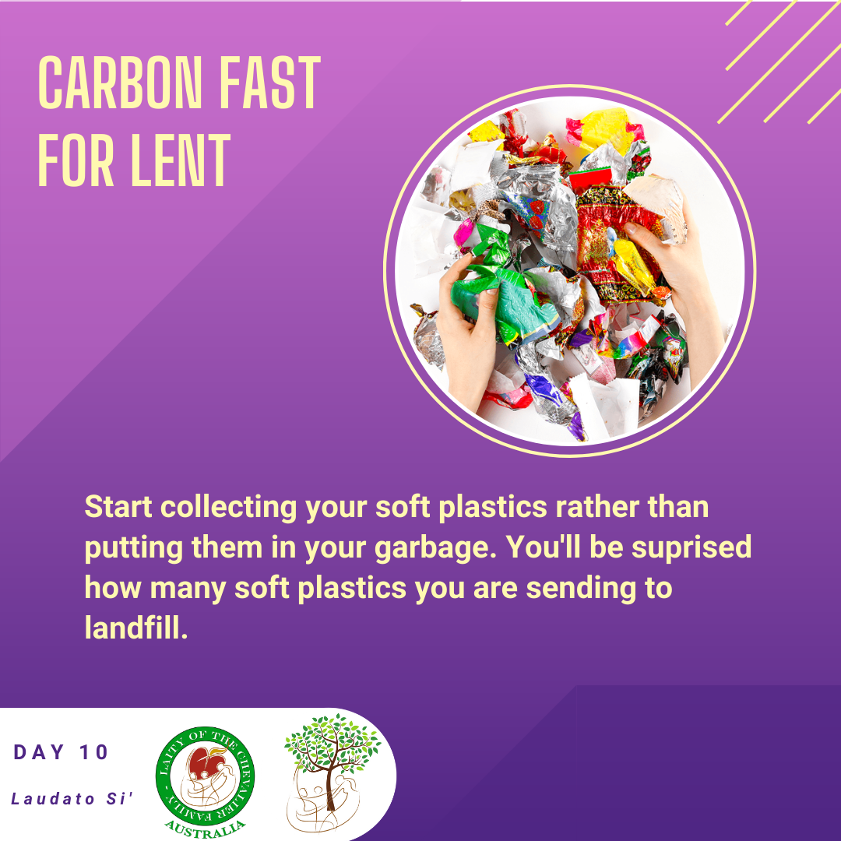
Laity of the Chevalier Family Australia
Spirituality of the Heart in an Australian Lay Context

Slide 13
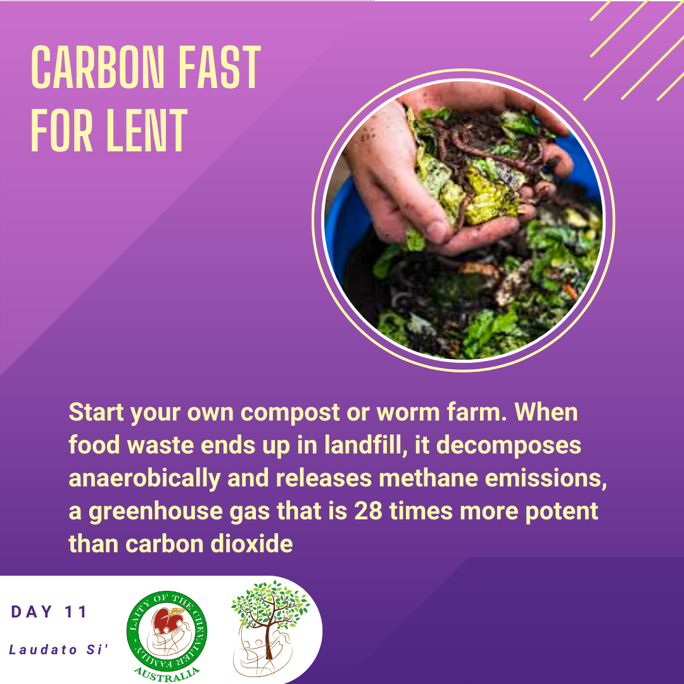
Laity of the Chevalier Family Australia
Spirituality of the Heart in an Australian Lay Context

Slide 14
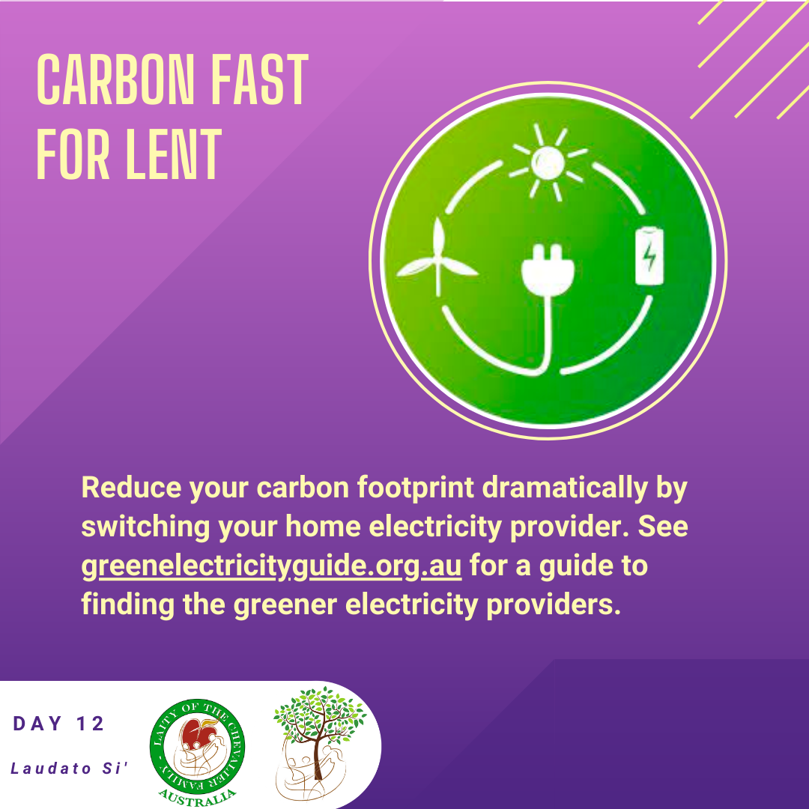
Laity of the Chevalier Family Australia
Spirituality of the Heart in an Australian Lay Context

Slide 15
Laity of the Chevalier Family Australia
Spirituality of the Heart in an Australian Lay Context

Slide 16
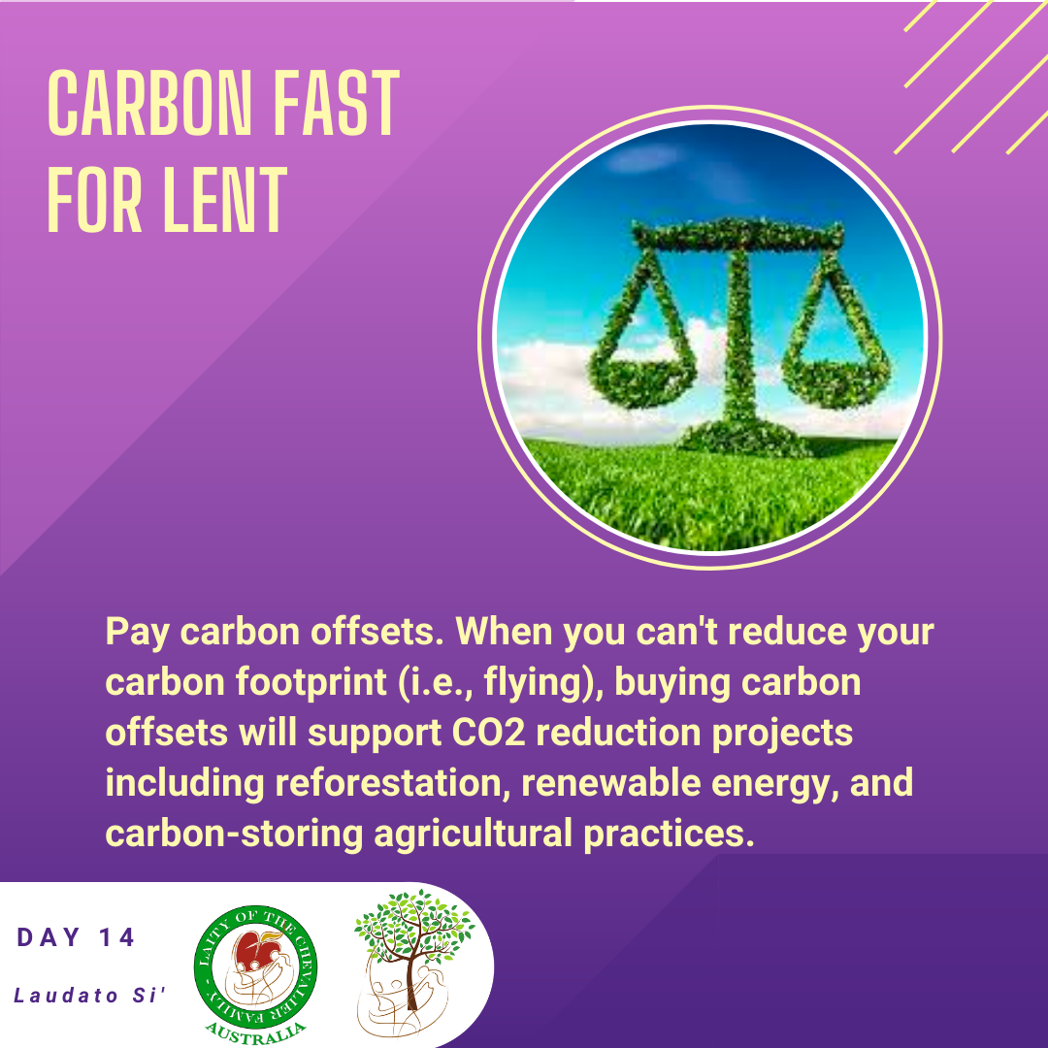
Laity of the Chevalier Family Australia
Spirituality of the Heart in an Australian Lay Context

Slide 17
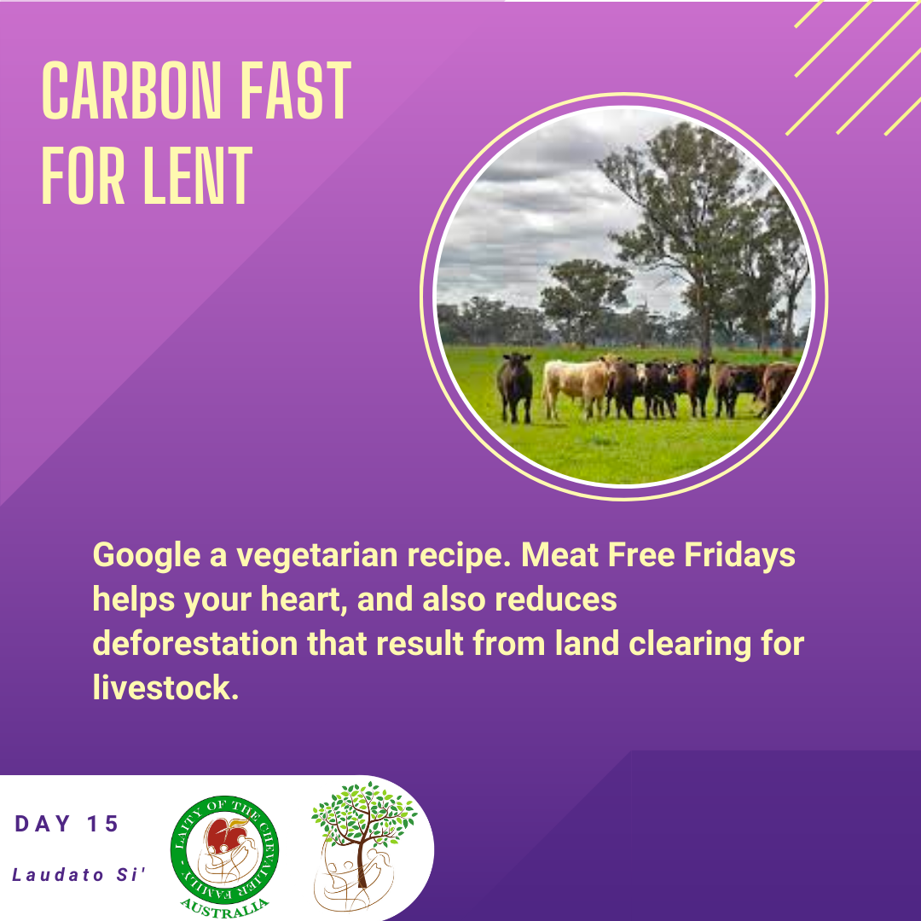
Laity of the Chevalier Family Australia
Spirituality of the Heart in an Australian Lay Context

Slide 18
Laity of the Chevalier Family Australia
Spirituality of the Heart in an Australian Lay Context

Slide 19
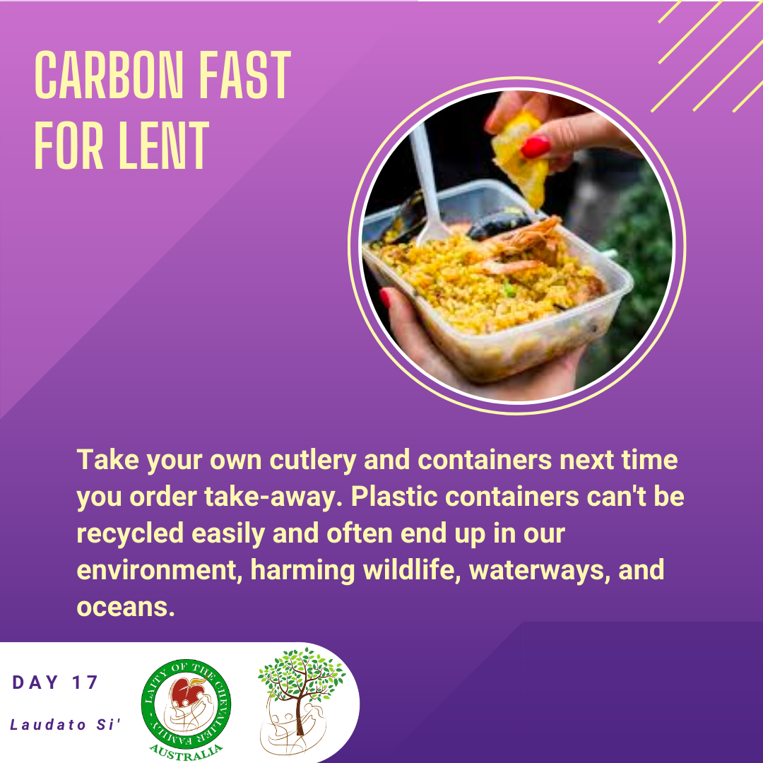
Laity of the Chevalier Family Australia
Spirituality of the Heart in an Australian Lay Context

Slide 20
Laity of the Chevalier Family Australia
Spirituality of the Heart in an Australian Lay Context

Slide 21
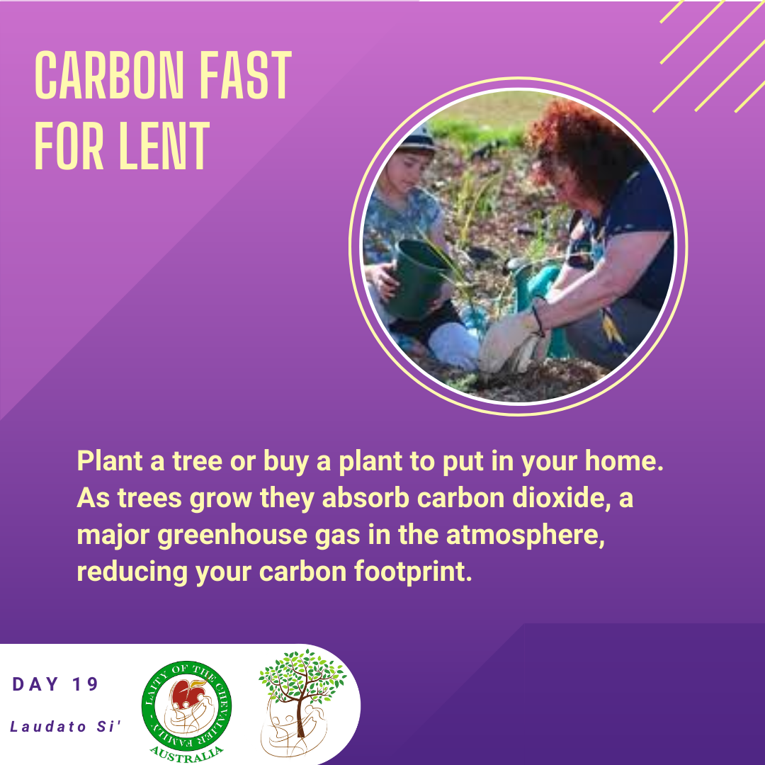
Laity of the Chevalier Family Australia
Spirituality of the Heart in an Australian Lay Context

Slide 22
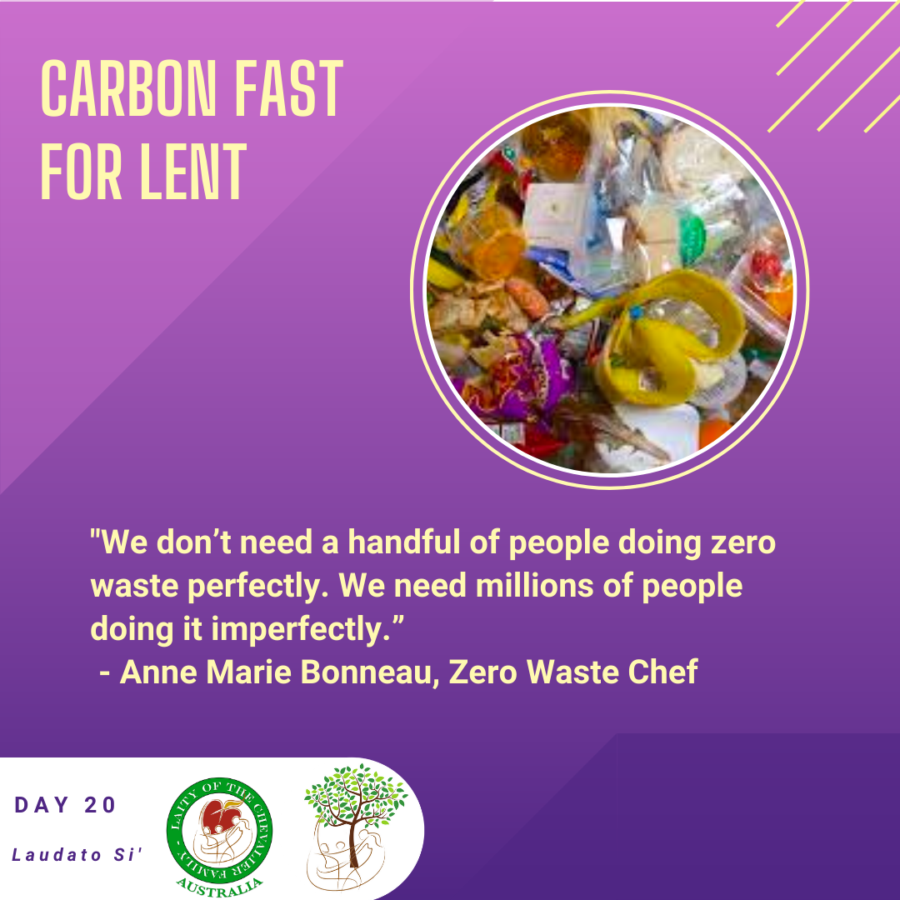
Laity of the Chevalier Family Australia
Spirituality of the Heart in an Australian Lay Context

Slide 23
Laity of the Chevalier Family Australia
Spirituality of the Heart in an Australian Lay Context

Slide 24
Laity of the Chevalier Family Australia
Spirituality of the Heart in an Australian Lay Context

Slide 25
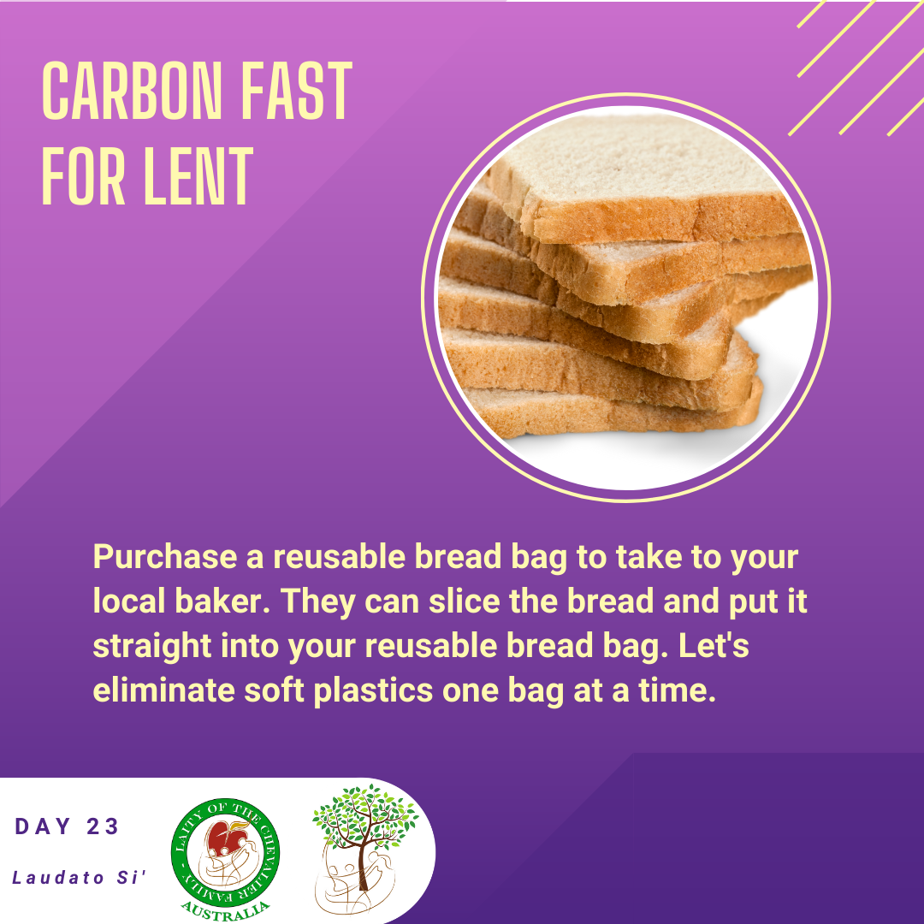
Laity of the Chevalier Family Australia
Spirituality of the Heart in an Australian Lay Context

Slide 26
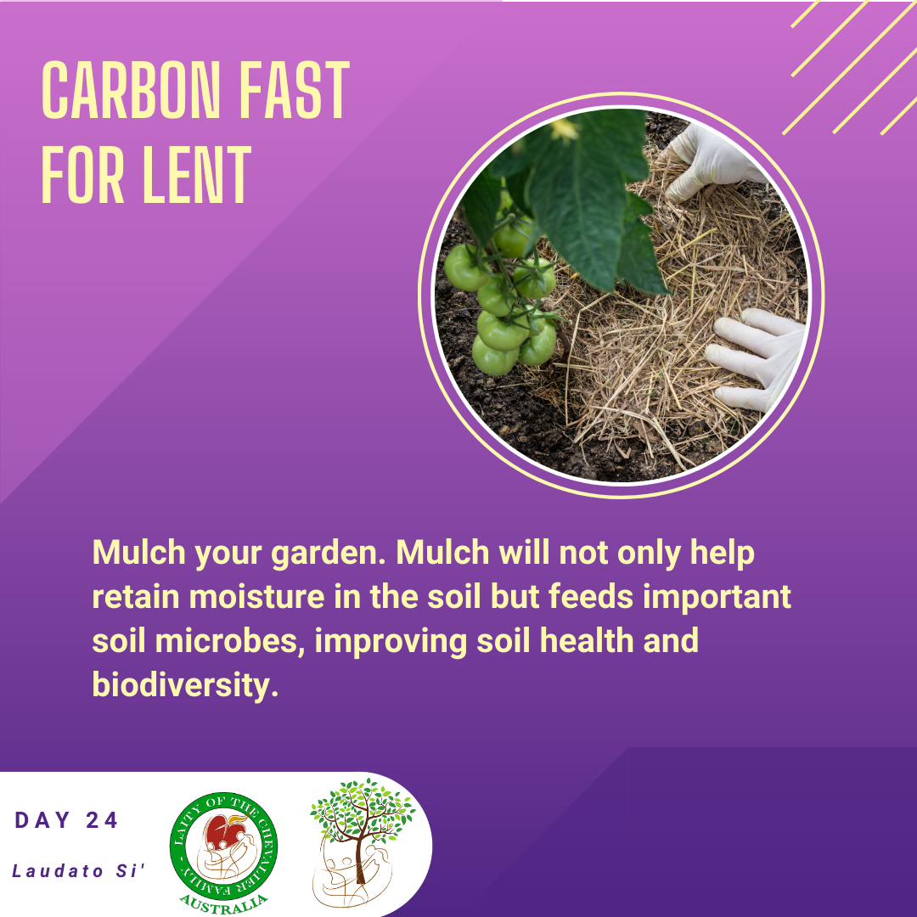
Laity of the Chevalier Family Australia
Spirituality of the Heart in an Australian Lay Context

Slide 27
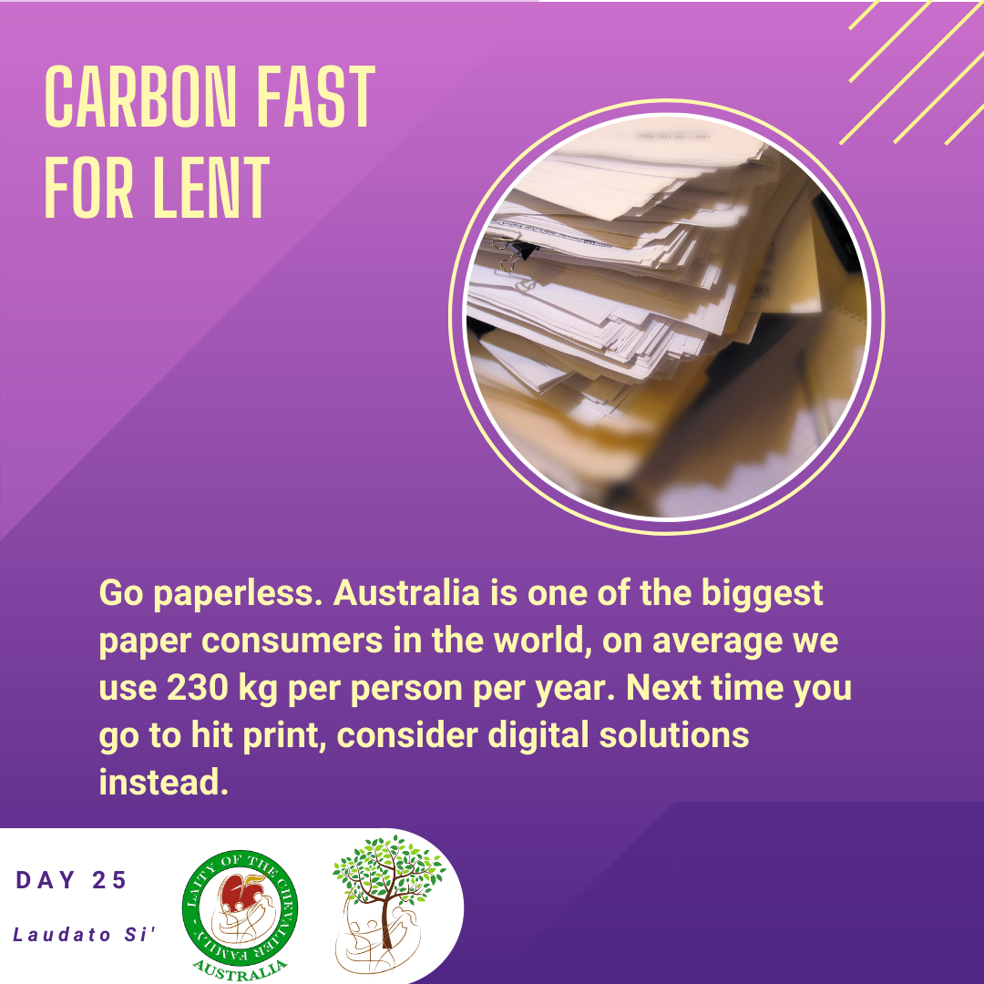
Laity of the Chevalier Family Australia
Spirituality of the Heart in an Australian Lay Context

Slide 28
Laity of the Chevalier Family Australia
Spirituality of the Heart in an Australian Lay Context

Slide 29
Laity of the Chevalier Family Australia
Spirituality of the Heart in an Australian Lay Context

Slide 30
Laity of the Chevalier Family Australia
Spirituality of the Heart in an Australian Lay Context

Slide 31
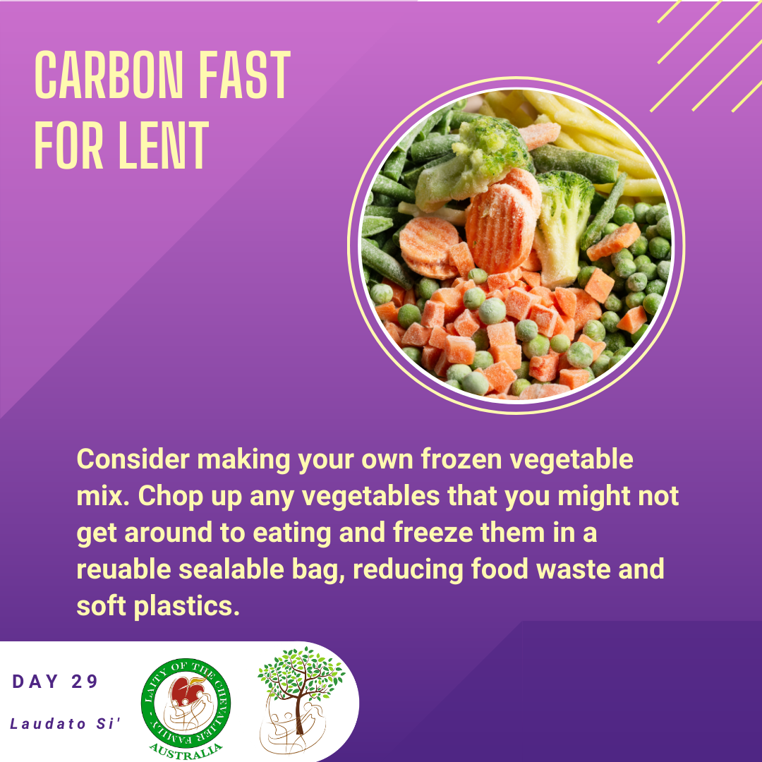
Laity of the Chevalier Family Australia
Spirituality of the Heart in an Australian Lay Context

Slide 32
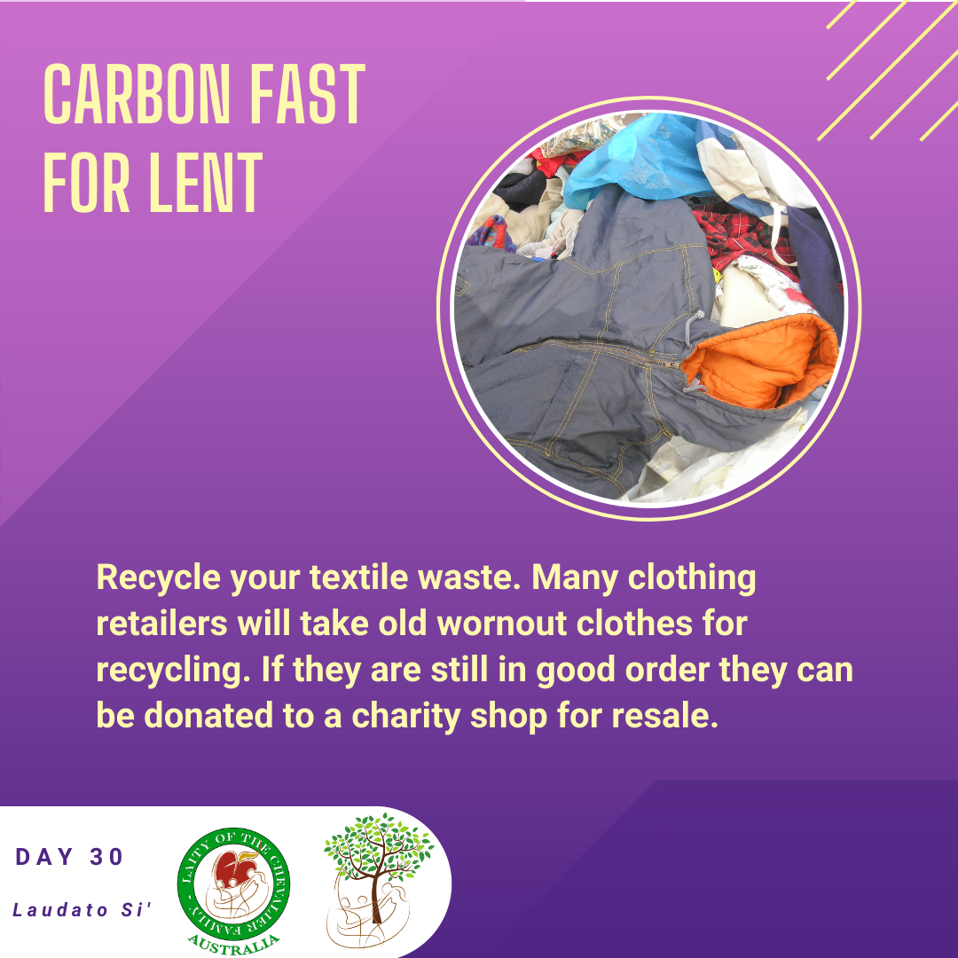
Laity of the Chevalier Family Australia
Spirituality of the Heart in an Australian Lay Context

Slide 33
Laity of the Chevalier Family Australia
Spirituality of the Heart in an Australian Lay Context

Slide 34
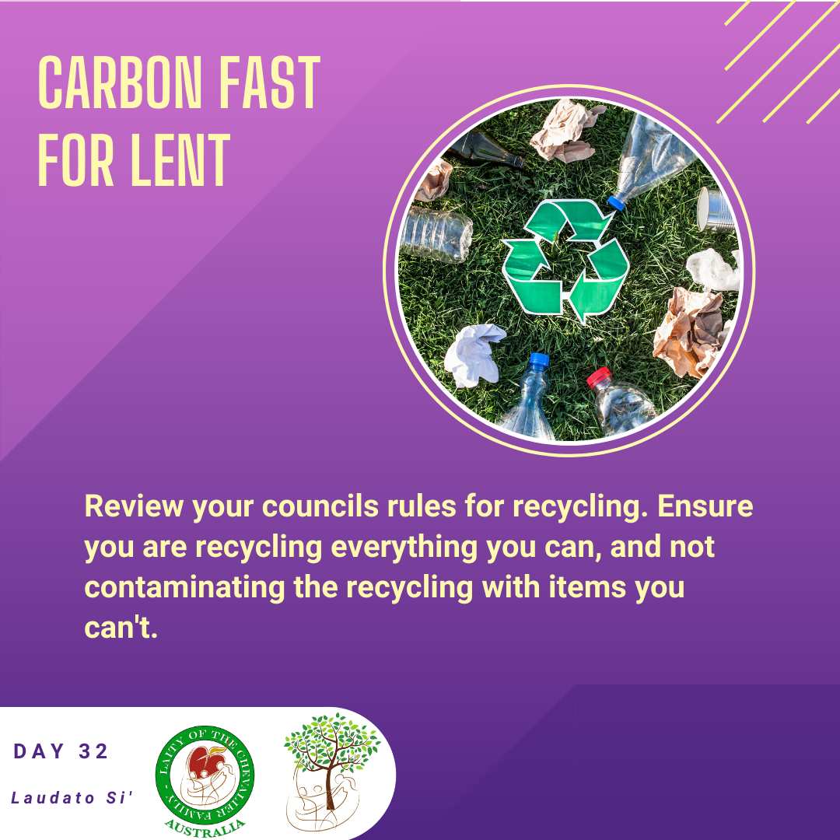
Laity of the Chevalier Family Australia
Spirituality of the Heart in an Australian Lay Context

Slide 35
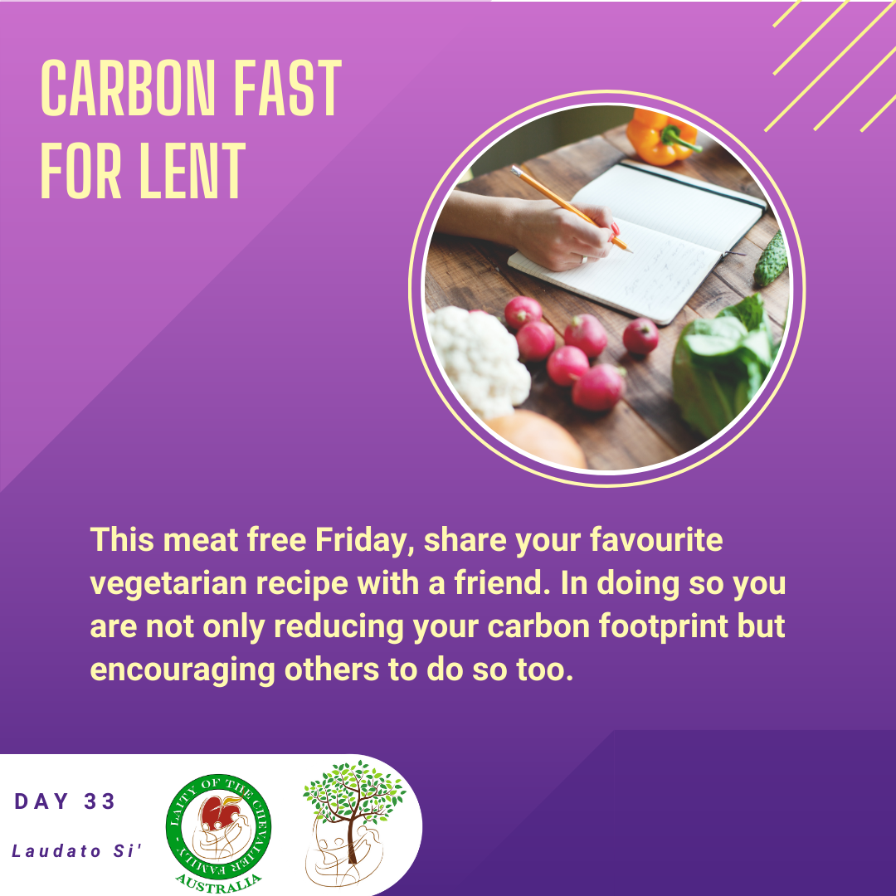
Laity of the Chevalier Family Australia
Spirituality of the Heart in an Australian Lay Context

Slide 36
Laity of the Chevalier Family Australia
Spirituality of the Heart in an Australian Lay Context

Slide 37
Laity of the Chevalier Family Australia
Spirituality of the Heart in an Australian Lay Context

Slide 38
Laity of the Chevalier Family Australia
Spirituality of the Heart in an Australian Lay Context

Slide 39
Laity of the Chevalier Family Australia
Spirituality of the Heart in an Australian Lay Context

Slide 40
Laity of the Chevalier Family Australia
Spirituality of the Heart in an Australian Lay Context

Slide 41
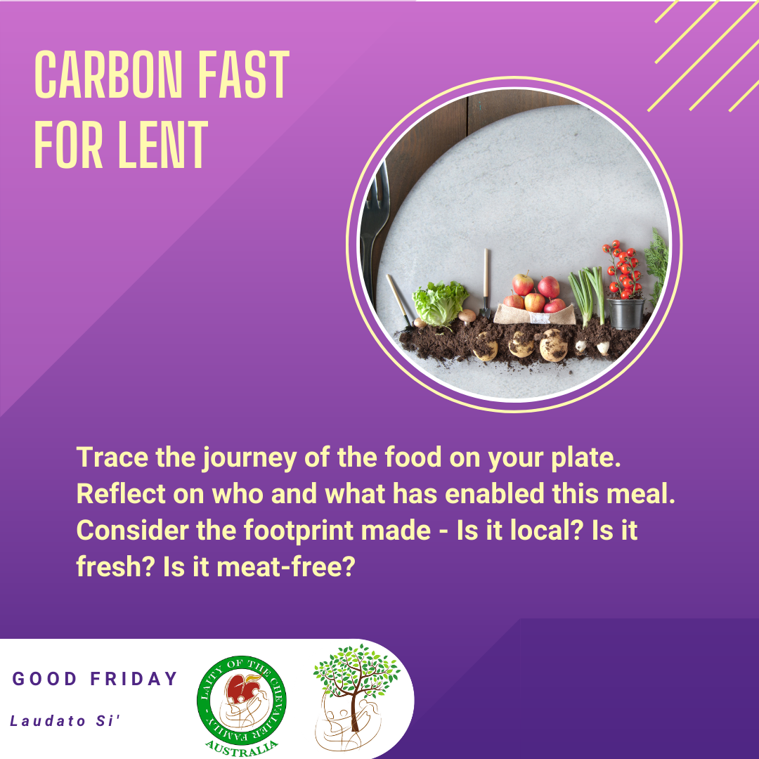
Laity of the Chevalier Family Australia
Spirituality of the Heart in an Australian Lay Context

Slide 42
Laity of the Chevalier Family Australia
Spirituality of the Heart in an Australian Lay Context

